Slide 1

machine learning using holdout method
TO - DR. Rajwant Singh Rao
Assistant Professor of CSIT , GGU
MCA 3RD Semester
BY- Rahul kumar
Roll No - 22072141

Slide 2
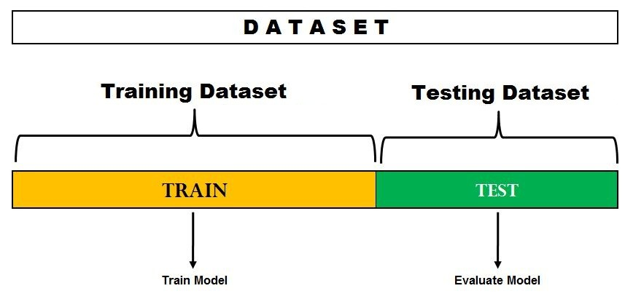
introduction
we'll walk you through the process of training a machine learning model on a dataset, evaluating its performance, and estimating its predictive accuracy. Specifically, we'll be using the holdout method to split our dataset into a training set (80%) and a testing set (20%).

Slide 3

Dataset Overview
Source of the dataset- https://www.kaggle.com/
Number of features- 13
Number of samples- 615

Slide 4

TECHNOLOGIES USED
Python
Development Environment
Python Libraries
Pandas
NumPy
Scikit-learn
Matplotlib and Seaborn
Additional Libraries
IDEs or Code Editors

Slide 5

NUMPY AND pandas
NumPy
NumPy is a fundamental library for numerical and scientific computing in Python.
Pandas
Pandas is a powerful library for data manipulation and analysis. We'll use it to load and preprocess the dataset.

Slide 6
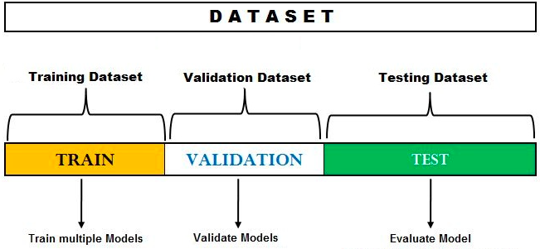
HOLDOUT METHOD
The holdout method is a widely used technique in machine learning for evaluating the performance of predictive models.
It involves dividing the dataset into two subsets: the training set and the testing set.
The training set is used to train the model, while the testing set is used to evaluate its performance.

Slide 7
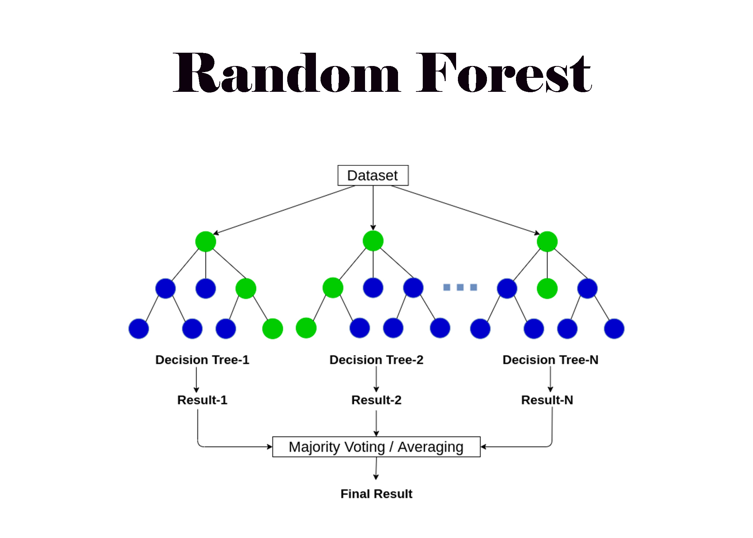
RANDOM FOREST
Random Forest is a powerful and versatile ensemble learning algorithm that belongs to the family of decision tree-based methods.
Random Forest is highly flexible and can handle both classification and regression tasks.
It is robust to overfitting and performs well on a wide range of datasets without extensive hyperparameter tuning.
Random Forest provides estimates of feature importance, which can be useful for feature selection and interpretation.

Slide 8
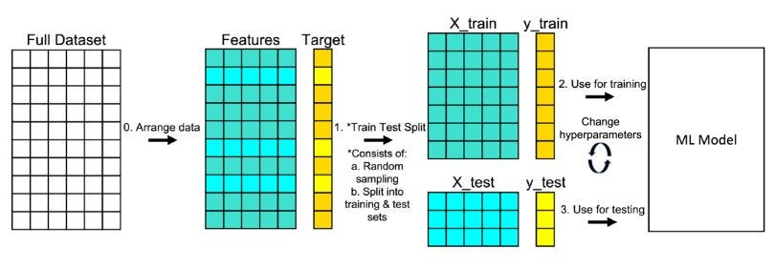
WORKIN DIAGRAM

Slide 9
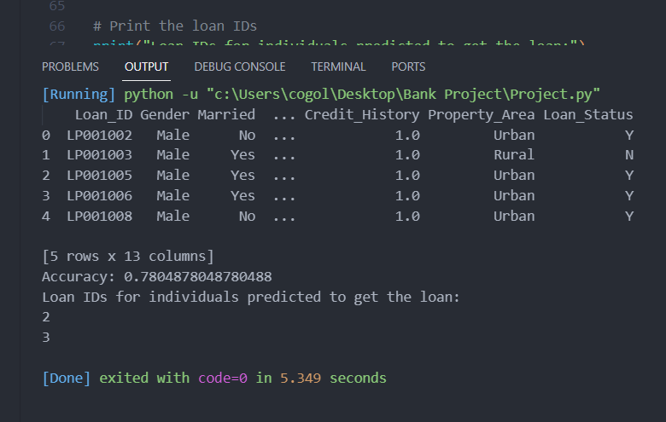
output

Slide 10

limitations
Limited Dataset Size
Single Algorithm Approach
Fixed Train-Test Split Ratio
Evaluation Metrics
Lack of Feature Engineering
Deployment Considerations

Slide 11
Thanks!
Any questions?

